Slide 1
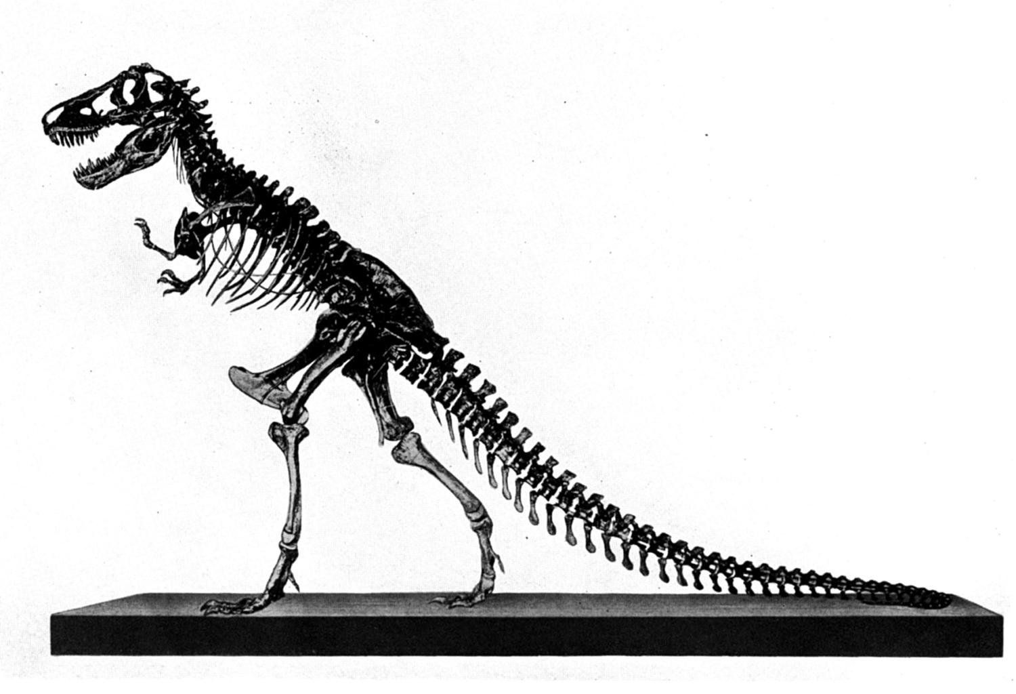
Behemoth &
Leviathan
Job 40:15-41:34
(context)
Part 2c

Slide 2
Review:
1 evidence for dinosaurs and man living together
2_{a} the conflict between Job and his friends and between Job and God
2_{b} Elihu’s response
2_{c} Jehovah’s 1st response
concept
Today’s Lesson
context

Slide 3

God Answers (Job 38:1-3)
1 Then the LORD answered Job out of the whirlwind, and said:
2 "Who is this who darkens counsel By words without knowledge?
3 Now prepare yourself
like a man; I will question
you, and you shall answer Me.

Slide 4
Job 38:4-7
"Where were you when I laid the foundations of the earth? Tell Me, if you have understanding” (Job 38:4)
Foundational: Creator | Creation
  Was Job at creation?
  Was Job able to create anything?
  Was Job able to advise and oversee the creation project?
  No right for the created to criticize the Creator!

Slide 5

Present at creation (38:4-7)?
Contain the sea (38:8-11)?
Command the day (38:12-15)?
Entered into the unseen (38:16-18)
Age so great to have seen where light comes from (38:19-21)?

Slide 6
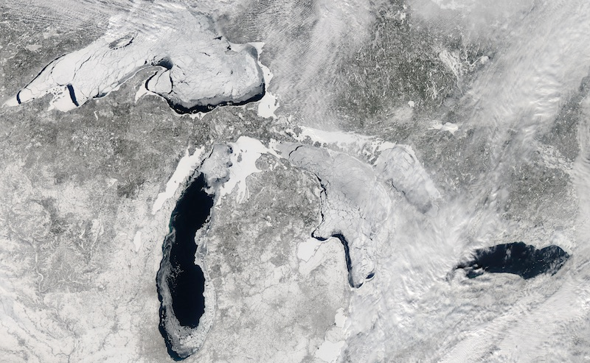
Viewed the treasury of snow, hail, etc. (38:22-30)?
The Moderate Resolution Imaging Spectroradiometer (MODIS) on NASA's Aqua satellite captured this image on Feb. 19, 2014 when 80.3 % of the 5 lakes were covered in ice
http://www.livescience.com/43569-ice-covered-great-lakes-photo.html

Slide 7
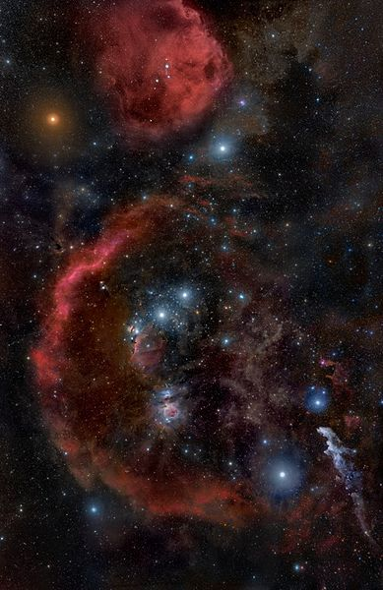
Bind, loose and guide the stars (38:31-33)?
Orion, Wikimedia Commons

Slide 8
A rainmaker (38:34-38)?
Satisfy and preserve animal life (38:39-41)?
Other questions about animal life
(39:1-30)

Slide 9
“Shall the one who contends with the Almighty correct Him? He who rebukes God, let him answer it” (Job 40:2)

Slide 10
God’s Answer/Courtroom
Was not what Job expected
Was not a place where God would be convicted of any illegality
Was not a place where God would apologize for what happened to Job
Was an overwhelming interrogation of Job

Slide 11
Job’s Response (Job 40:3-5)
3 Then Job answered the LORD and said:
4 "Behold, I am vile; What shall I answer You? I lay my hand over my mouth.
5 Once I have spoken, but I will not answer; Yes, twice, but I will proceed no further."

Slide 12
Behemoth & Leviathan
Job 40, 41 MUST follow the same pattern and meaning to the Lord’s first response
Whatever Behemoth and Leviathan are, they MUST be literal!
  Designed to produced humility

Slide 13
1 Peter 4:18
“Now ‘If the righteous one is scarcely saved, Where will the ungodly and the sinner appear?’”

